Slide 1
DL - Fraud Detection in Time Series
Deep Learning
> Fraud Detection <
Aitor Artero, Víctor Herrero

Slide 2
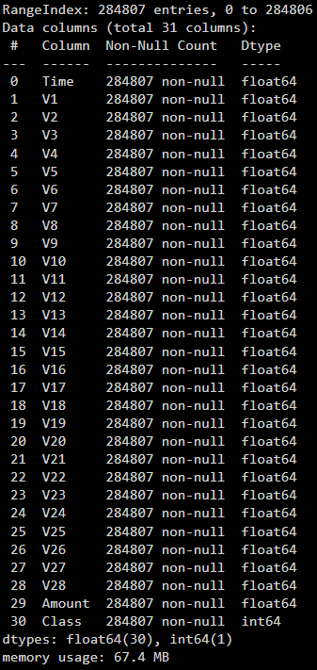
> Description of the dataset used.
Our dataset comprises credit card transactions conducted over a weekend period, containing 31 features. The time-stamped data includes 28 anonymized features (V1-V28) derived from PCA transformation of the original dataset, which cannot be distributed due to obvious privacy considerations. Additional features include the transaction amount in dollars and a binary classification label indicating whether a transaction was fraudulent. This dataset represents real transactions made by European cardholders in September 2013, with fraudulent transactions constituting only 0.17% of all cases.

Slide 3
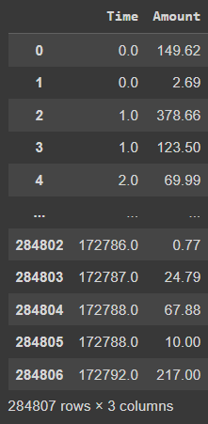
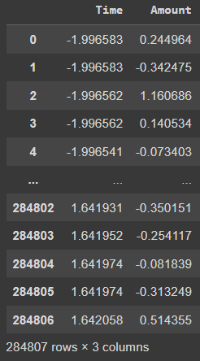
> Data Preprocessing: Feature Scaling.
Normalized “Time” and “Amount” features to avoid feature dominance, preventing bias towards higher larger numerical ranged features and, at the same time, increasing the models performance and generalization
We also scaled all the PCA-derived columns (from V1 to V28)

Slide 4
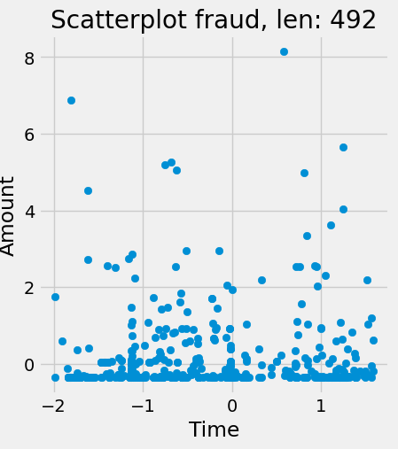
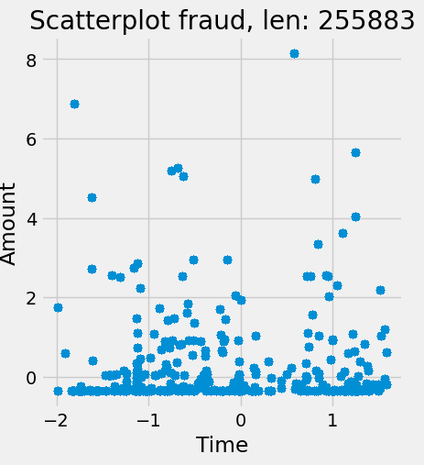
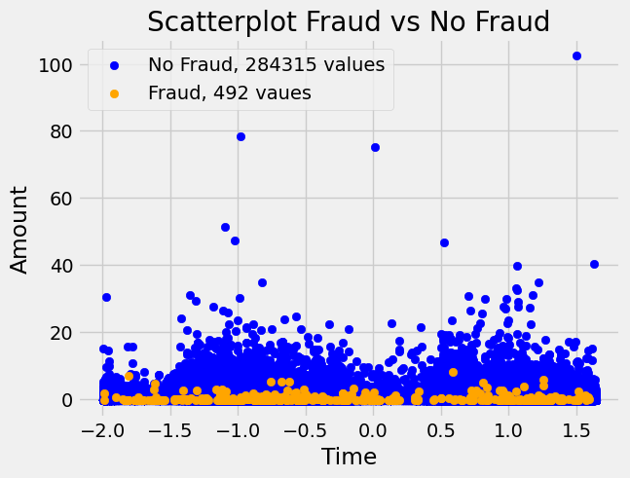
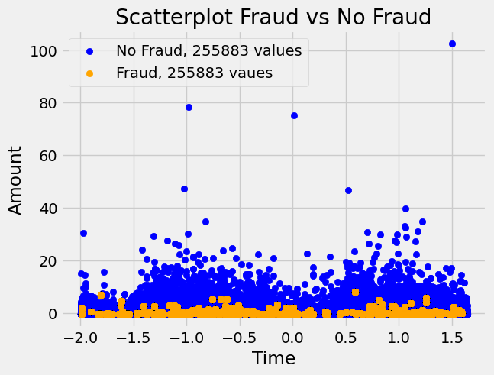
> Data Preprocessing: Addressing Class Imbalance.
To address the significant class imbalance (0.17% fraud cases), we implemented two distinct approaches:
Weighted Approach:
Applied class weights in the loss function
Maintained the original data distribution
Assigned higher importance to minority class samples
Upsampling Approach:
Generated synthetic minority class samples
Created a balanced training dataset
Synthetic samples were derived from existing fraud patterns while preserving the statistical properties of the original fraud cases

Slide 5
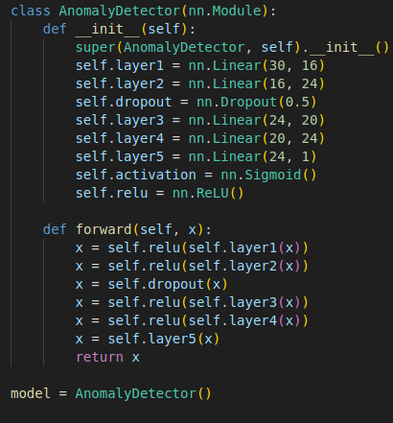
> Choice and Description of the Model Architecture.
Our anomaly detection network consists of a carefully designed architecture with six layers:
Input Layer: 30 nodes corresponding to all input features
First Hidden Layer: 16 nodes with ReLU activation
Dropout Layer: Randomly zeroes outputs to prevent overfitting
Second Hidden Layer: 16 nodes with ReLU activation
Third Hidden Layer: 20 nodes with ReLU activation
Output Layer: Single node producing the classification result
The forward propagation process applies sequential linear transformations and activation functions through each layer. We eliminated the Sigmoid activation in the output layer since our loss function (BCEWithLogitsLoss) incorporates this transformation internally for improved numerical stability.

Slide 6
> Training Process and Hyperparameter Tuning.
Given the inherent security of online banking transactions, detecting fraudulent activities presents significant challenges. To address the extreme class imbalance, we employed BCEWithLogitsLoss, which combines a sigmoid activation function with binary cross-entropy loss, providing both numerical stability and computational efficiency.
We implemented an early stopping mechanism to optimize training duration, halting the process if validation loss fails to improve over five consecutive epochs. This approach typically resulted in convergence between the eighth and ninth epochs. While we initially considered Optuna for hyperparameter optimization, the exceptional performance of our initial configuration rendered further optimization unnecessary.

Slide 7
> Model Evaluation Methodology.
We conducted comprehensive model evaluation using multiple complementary metrics:
Accuracy: Overall correct classification rate
Precision: Proportion of true positives among positive predictions
Recall: Proportion of actual positives correctly identified
F1 Score: Harmonic mean of precision and recall
Confusion Matrix: Detailed breakdown of prediction categories
AUC (Area Under ROC Curve): Model's ability to discriminate between classes
For imbalanced classification problems, relying solely on accuracy or precision can be misleading. Our multi-metric approach provides a holistic evaluation that guards against overfitting and ensures real-world applicability

Slide 8
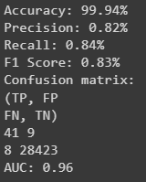
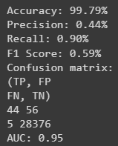
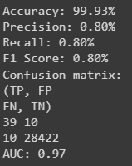
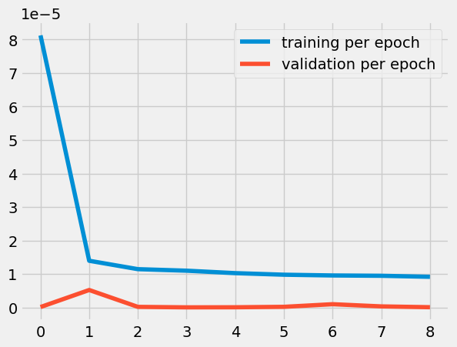
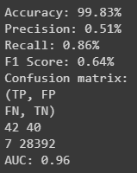
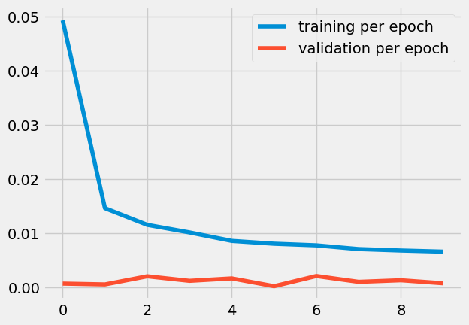
> Results Obtained and Comparison with other Approaches.
Weights
Achieved balanced precision and recall
Better generalization to unseen data
Upsampling
Slightly higher recall at a minor cost to precision
Potentially more sensitive to novel fraud patterns (less FN)

Slide 9
> Future Improvements (1/3).
As a potential future improvement, acquiring additional fraud examples would enhance the model's ability to generalize without the need for synthetic data generation. By including more real instances of fraud, the model would have a broader and more representative dataset, leading to better performance in detecting various fraud patterns.
Expanding the dataset beyond a weekend would also be beneficial, as it would allow the model to capture more long-term trends, such as weekly or monthly patterns. This extended temporal coverage would provide the model with a richer context, improving its ability to recognize fraud within different time frames.

Slide 10
> Future Improvements (2/3).
Combining our weighted and upsampling approaches through ensemble techniques could leverage the strengths of both methodologies while mitigating their individual weaknesses. This fusion would create a more robust system capable of maintaining high precision while simultaneously improving recall, ultimately enhancing overall detection performance.
Exploring sophisticated sampling methods like SMOTE (Synthetic Minority Over-sampling Technique) could provide higher-quality synthetic examples compared to our current upsampling approach. These techniques generate minority class samples in feature spaces where they are most needed, creating more representative synthetic fraud patterns that better capture the complexity of real fraudulent transactions.
Implementing advanced explainability frameworks such as SHAP (SHapley Additive exPlanations) or LIME (Local Interpretable Model-agnostic Explanations) would provide valuable insights into which features drive model decisions. This transparency would not only improve stakeholder trust but also enable targeted feature engineering and help identify potential biases in the detection system.

Slide 11
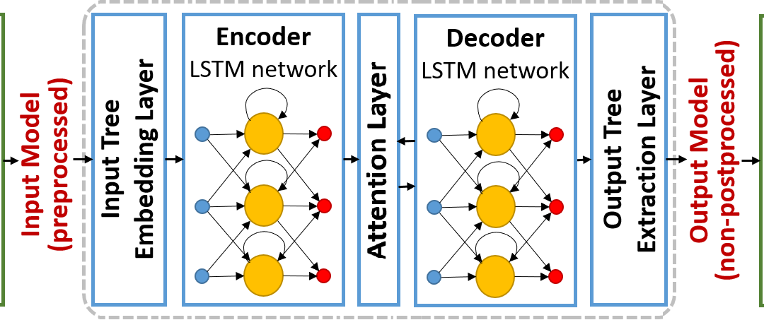
> Future Improvements (3/3).
As a potential improvement, we considered implementing an Autoencoder with an LSTM-based encoder and decoder, given that our previous research indicated that this type of architecture performs exceptionally well for anomaly detection in time series. However, due to the excellent results we achieved using Autoencoders alone, we determined that the additional complexity was unnecessary. Moreover, since our dataset spans only a weekend (two days), an LSTM neural network would likely not be effective, as it would lack sufficient data to adequately learn and model patterns.

Slide 12
> Conclusion.
This project has provided valuable insights into neural network application for fraud detection. The process of selecting appropriate architectures and methodologies has deepened our understanding of deep learning approaches to anomaly detection. The iterative refinement process—constantly evaluating and adapting our methods to address the unique challenges of fraud detection—has been particularly instructive.
The techniques explored in this project have broader applications beyond fraud detection, potentially extending to anomaly detection in various domains such as cybersecurity, manufacturing quality control, and healthcare monitoring systems.

